Slide 1
Systems lecture 6

Slide 2
System
A system is formally defined as an entity that manipulates one or more signals to accomplish a function, thereby yielding new signals.
Input signal
System
Output signal

Slide 3

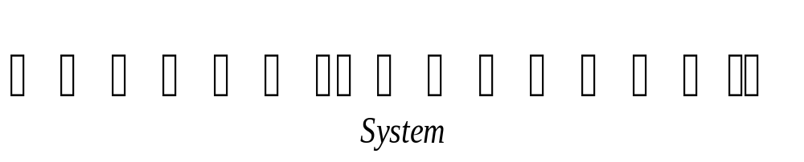
Examples of Systems
In a communication system, the input signal could be a speech signal or computer data, the system itself is made up of the combination of a transmitter, channel and receiver and the output signal is a an estimate of the information contained in the original message.

Slide 4
Examples of Systems
In an automatic speaker recognition system, the input signal is a speech (voice) signal, the system is a computer, and the output signal is the identity of the speaker.

Slide 5
Systems Viewed as Interconnections of Operation
In mathematical term, a system may be viewed as an interconnection of operation that transforms an input signal into an output signal with properties different from those of the input signal.
Let the overall operator H denote the action of a system. Then, the application of a continuous-time signal x(t) to the input of the system yields the output signal .
y(t)=H{x(t)}
x(t)
y(t)
H

Slide 6
Systems Viewed as Interconnections of Operation
Correspondingly, for the discrete-time case, we may write
y[n]=H{x[n]}
x[n]
y[n]
H

Slide 7
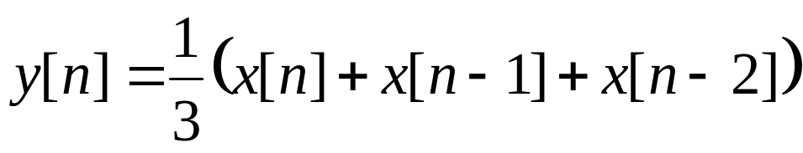
Systems Viewed as Interconnections of Operation
Consider a discrete-time system whose output signal y[n] is the average of the three most recent values of the input signal x[n]; that is
Such a system is referred to as a moving average system, for two reasons:
y[n] is the average of the sample values x[n], x[n-1] and x[n-2].
The value of y[n] changes as n moves along the discrete time axis.

Slide 8

Systems Viewed as Interconnections of Operation
Problem
Formulate the operator H for this system, hence develop a block diagram representation for it.
Solution
Let the operator S^{k} denote a system that shifts the input x[n] by k time units to produce an output equal to x[n-k].

Slide 9
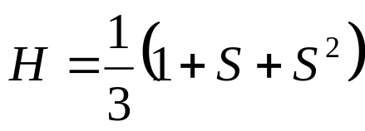
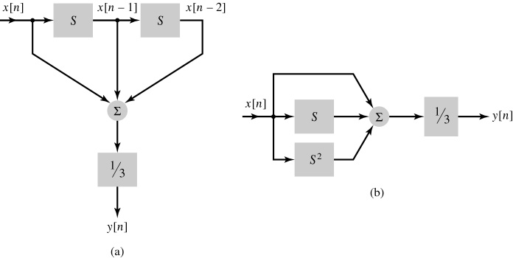
Systems Viewed as Interconnections of Operation
Solution-Continued
H can be written as,
Two different (but equivalent) implementations of the moving-average system: (a) cascade form of implementation and (b) parallel form of implementation.

Slide 10
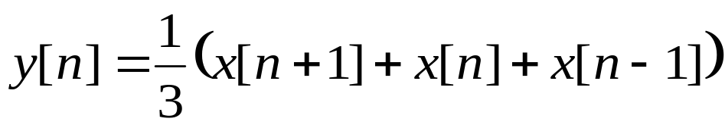
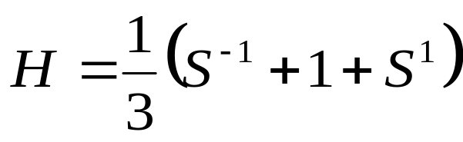
Systems Viewed as Interconnections of Operation
Problem
Express the operator that describes the input-output relation
In terms of the time-shift operator S.
Solution

Slide 11
Properties of system
Memory
A system is said to possess memory if its output signal depends on past or future values of the input signal.
In contrast, a system is said to be memoryless if its output depends only on the present value of the input signal.
The delay system,
y[n]=x[n-1]
must retain or store the preceding value of the input.

Slide 12
Properties of system
Memory
The system described by the input-output relation,
has memory, since the value of the output signal y[n] at time n depends on the present and on two past values of the input signal x[n].

Slide 13
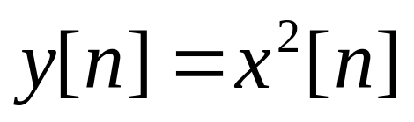
Properties of system
Memory
In contrast, a signal described by the input-output relation
is memoryless, since the value of the output signal y[n] at time n depends only on the present value of the input signal.

Slide 14
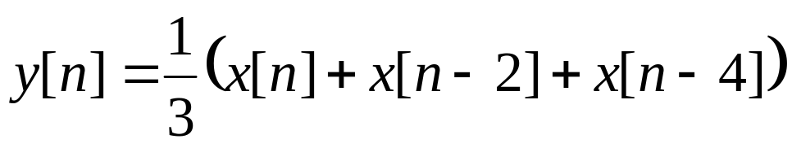
Properties of system
Memory (Problem)
How far does the memory of the moving –average system described by the input-output relation extend into the past?
Answer: Four time units

Slide 15
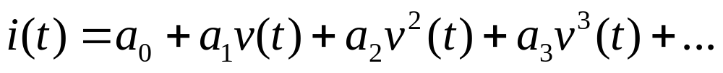
Properties of system
Memory (Problem)
The input-output relation of a semiconductor diode is represented by
where, v(t) is the applied voltage, i(t) is the current flowing through the diode, and a₀, a₁, a₂, a₃….. Are constants. Does the diode have memory?
Answer: No

Slide 16
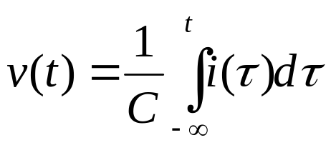
Properties of system
Memory (Problem)
The input-output relation of a capacitor is described by,
What is the extend of the capacitor’s memory?
Answer: The capacitor’s memory extends from time t back to the infinite past.

Slide 17

Properties of system
Causality
A system is said to be causal if the present value of the output signal depends only on the present or past values of the input signal.
For example, the moving-average system described by
is causal.

Slide 18
Properties of system
Causality
Some other examples of causal systems are given below:
𝑦[n]= 𝑥[n − 3] + 3𝑥[n]
y[n]=nx[n]
y[n]=x[n-1]+x[n]

Slide 19
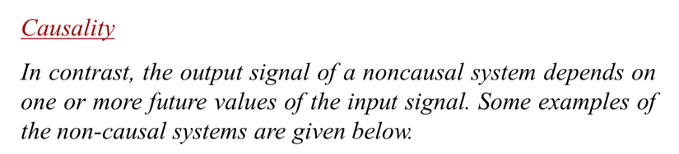
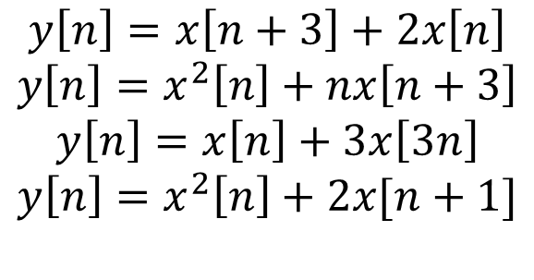
Properties of system

Slide 20
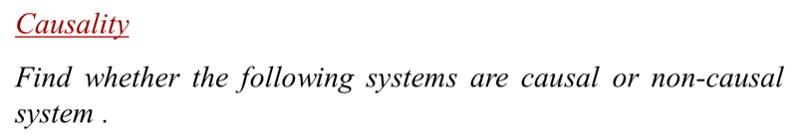

Properties of system
𝑦[n] = + 𝑥[n − 3]
𝑦[n] = 𝑥[3 − n] + 𝑥[n − 2]
𝑦[𝑛] = 𝑥[2𝑛]
𝑦[𝑛] = sin[𝑥[𝑛]]

Slide 21


Properties of system
Causality of the given system can be determined by considering different values of n as follows-
n = 0 → 𝑦[0] = 𝑥²[0] + 𝑥[−3]
n = −2 → 𝑦[−2] = 𝑥²[−2] + 𝑥[−5]
n = 2 → 𝑦[2] = 𝑥²[2] + 𝑥[−1]
Hence, for all the values of n, the output depends only on the present and past values of the input. Thus, the given system is a causal system.

Slide 22

Properties of system
Causality of the given system can be determined by considering different values of n as follows-
n = 0 → 𝑦[0] = 𝑥[3] + 𝑥[−2]
n= −1 → 𝑦[−1] = 𝑥[4] + 𝑥[−3]
n = 1 → 𝑦[1] = 𝑥[2] + 𝑥[−1]
Hence it is clear that , for some values of n, the output depends only on the future values of the input. Thus, the given system is a non-causal system.

Slide 23

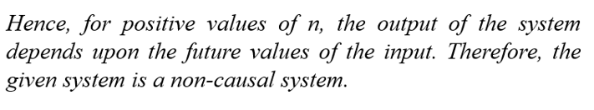
Properties of system
3. 𝑦[𝑛] = 𝑥[3𝑛]
𝑛 = 0 → 𝑦[0] = 𝑥[0]
𝑛 = −1 → 𝑦[−1] = 𝑥[−3]
𝑛 = 1 → 𝑦[1] = 𝑥[3]
𝑛 = 2 → 𝑦[2] = 𝑥[6]

Slide 24



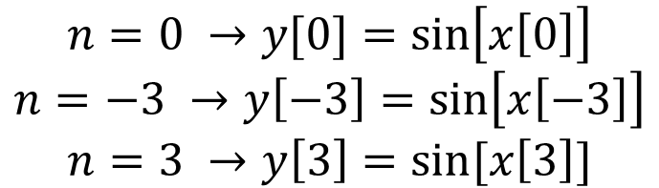
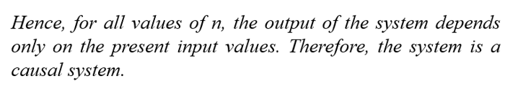
Properties of system

Slide 25

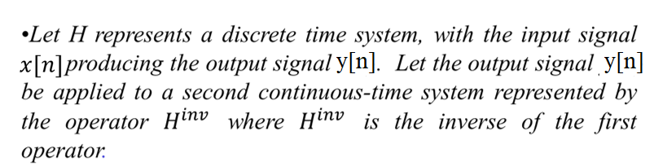
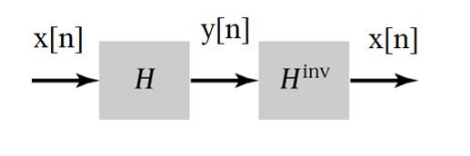
Properties of system

Slide 26
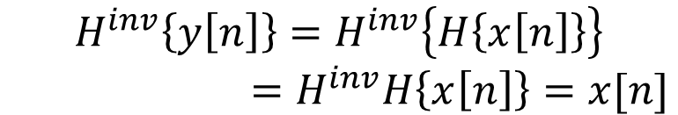
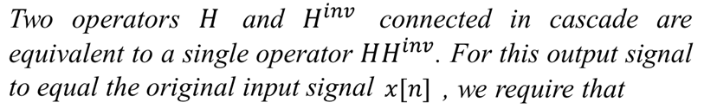

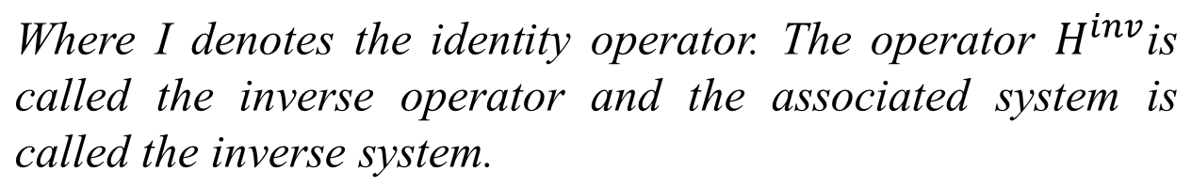
Properties of system
Invertibility
Then the output signal of the second system is defined by

Slide 27
Properties of system
Invertibility
A system is not invertible unless distinct inputs applied to the system produce distinct outputs. That is, there must be a one-to-one mapping between input and output signals for a system to be invertible.

Slide 28

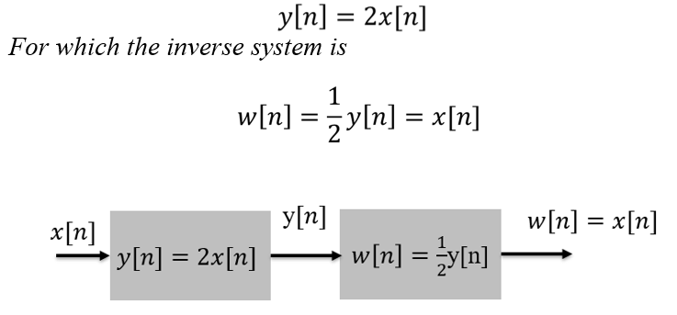
Properties of system
An example of an invertible discrete-time system is

Slide 29
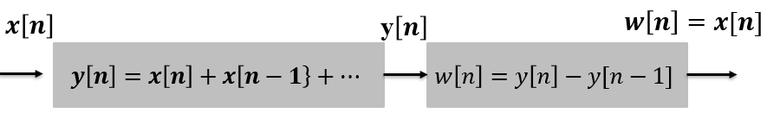
Properties of system
Invertibility
An example of an invertible discrete-time system is

Slide 30
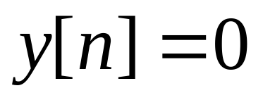
Properties of system
Invertibility
An example of a noninvertible system is
The system that produces the zero output sequence for any input sequence.

Slide 31

Properties of system
Invertibility
Show that a square-law system described by the input-output relation
is not invertible.
The square law system violates a necessary condition for inverse system, namely, that distinct input must produce distinct outputs. Here the distinct inputs x[n] and –x[n] produce the same output y[n].

Slide 32
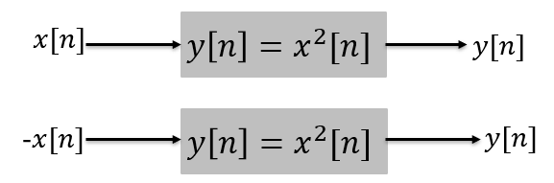
Properties of system
Invertibility (Problem)
We cannot determine the sign of the input from knowledge of the output.

Slide 33
Properties of system
Time Invariance
Let x[n] and y[n] be the input and output signals, respectively, of a system . Then the transformation of x[n] into y[n] is represented by the mathematical notation
y[n]=Hx[n]
Where H is the operator which defined rule by which x[n] is transformed into y[n].

Slide 34
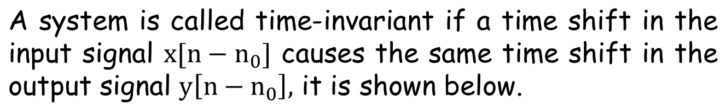


Properties of system
Time Invariance
System
H
Input Signal
Output Signal
Fig: Time Invariant System

Slide 35
Properties of system
Time Invariance (Example1)
Determine whether or not each of the following systems are time variant with input x[n] and output y[n].
y[n]=nx[n]

Slide 36
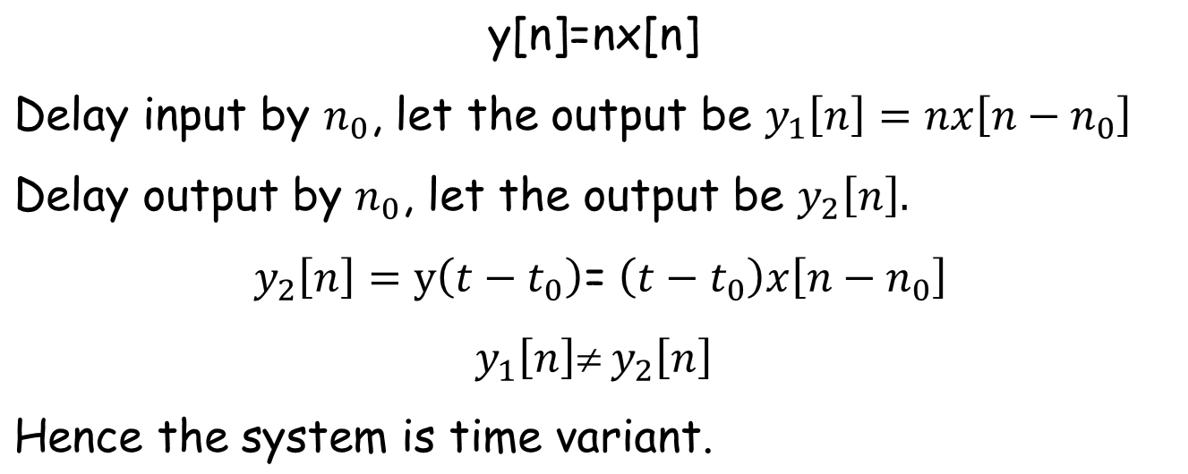
Properties of system
Time Invariance

Slide 37
Properties of system
Time Invariance

Slide 38
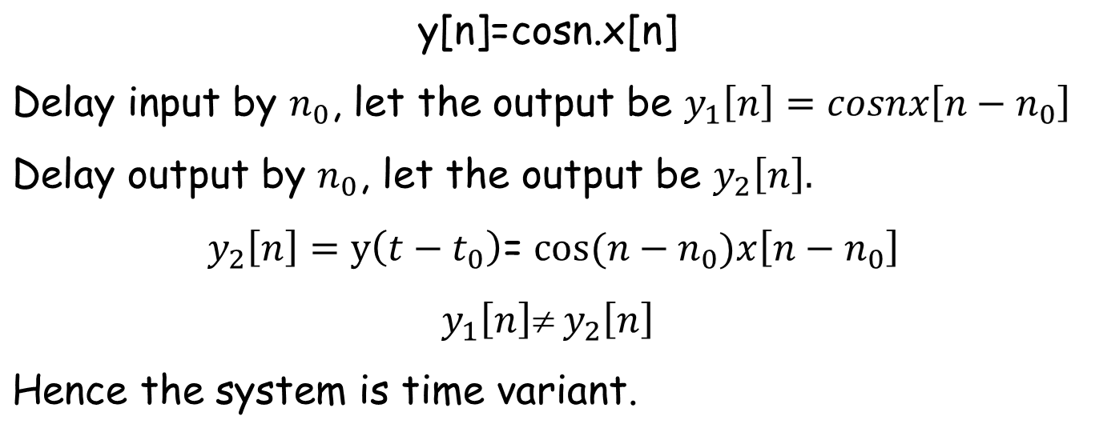
Properties of system
Time Invarianc(Example 2)

Slide 39
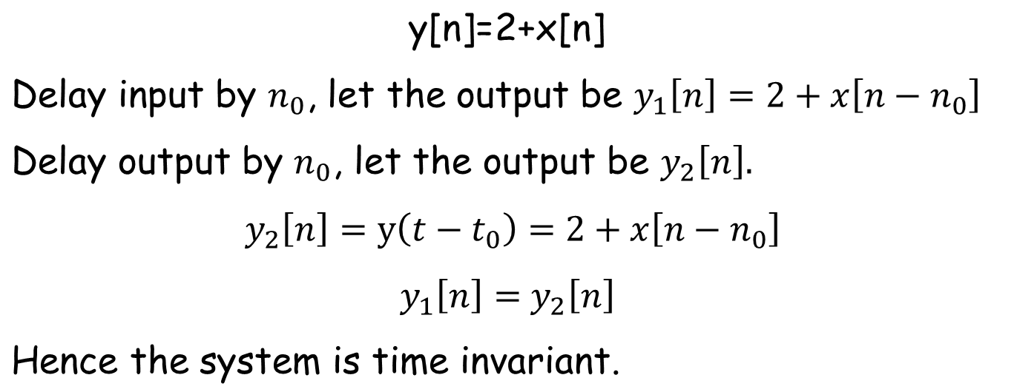
Properties of system
Time Invarianc(Example 3)

Slide 40
Properties of system
Linearity
A system is said to be linear in terms of system input x[n] and the system output y[n] if it satisfies the following two properties
Additive property
Homogeneity property

Slide 41
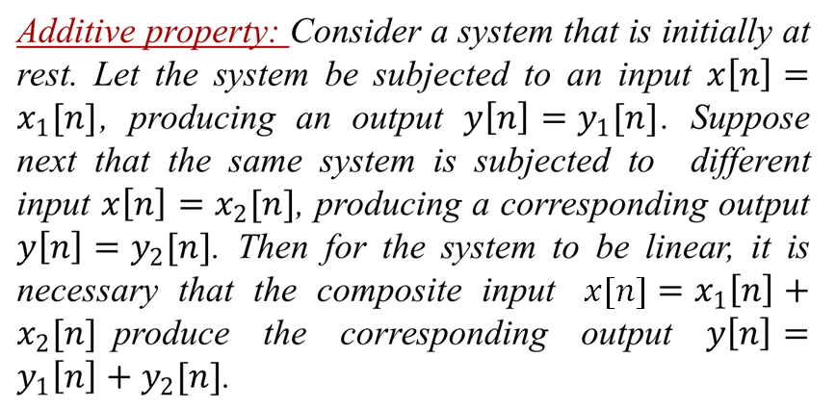
Properties of system
Linearity

Slide 42
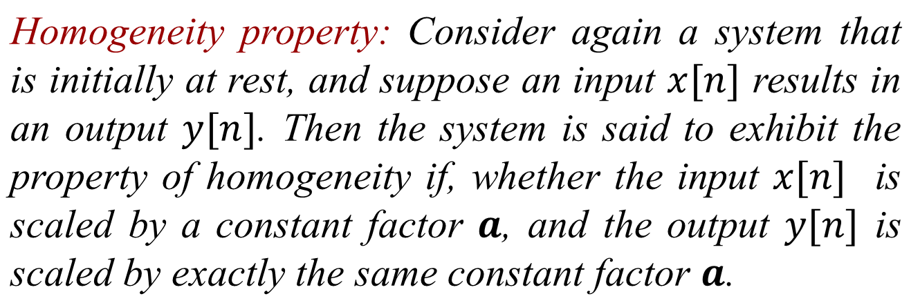
Properties of system
Linearity

Slide 43
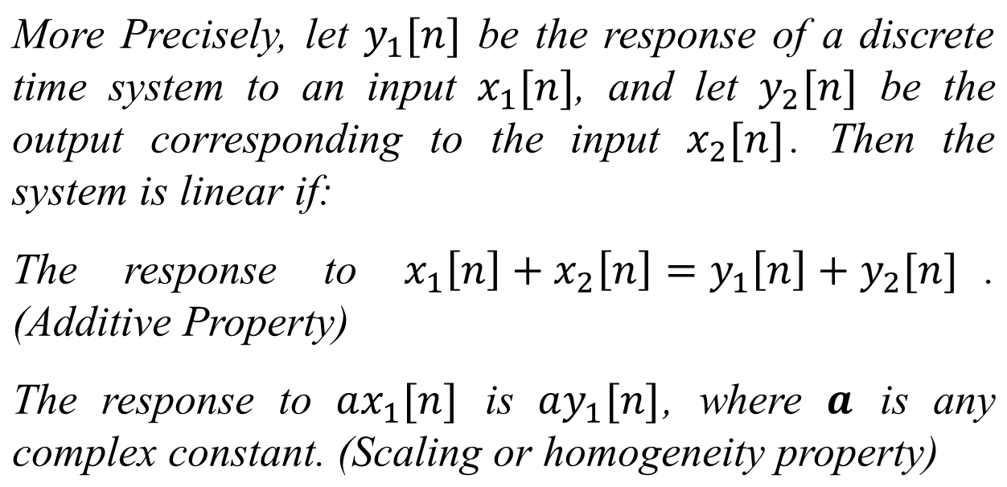
Properties of system
Linearity

Slide 44
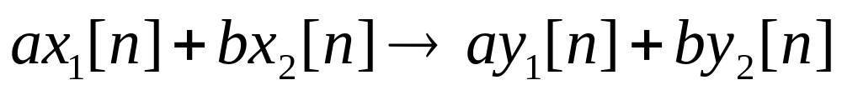
Properties of system
Linearity
The two properties defining a linear system can be combined into a single statement:
where, a and b are constants.

Slide 45
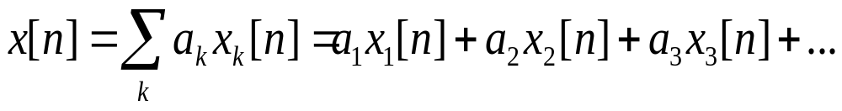
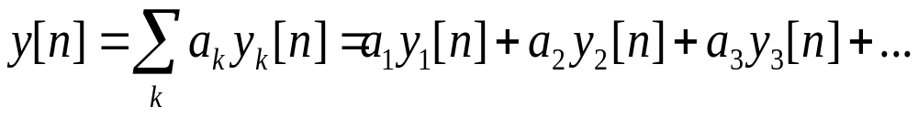
Properties of system
Linearity
Furthermore, it is straightforward to show from the definition of linearity that if x_{k}[n], k=1, 2, 3, …., then the response to a linear combination of these inputs given by,
is,
This very important fact is known as the superposition property, which holds for linear systems.

Slide 46
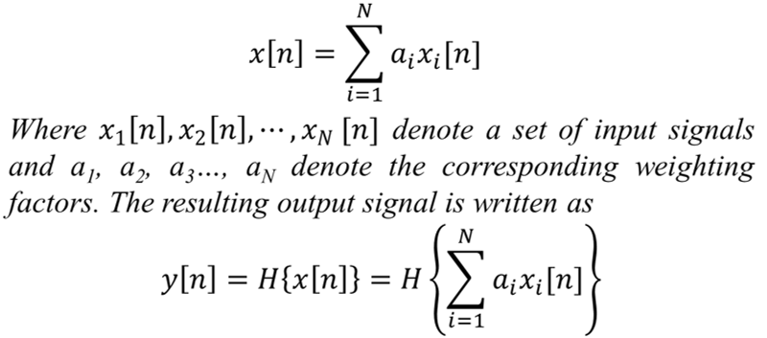
Properties of system
Linearity
Let the operator H represents a discrete-time system. Let the signal applied to the system input be defined by the weighted sum

Slide 47
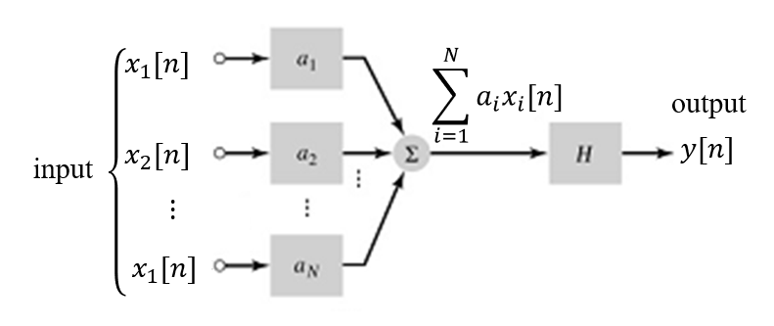
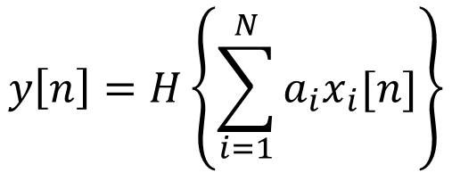
Properties of system
Linearity

Slide 48
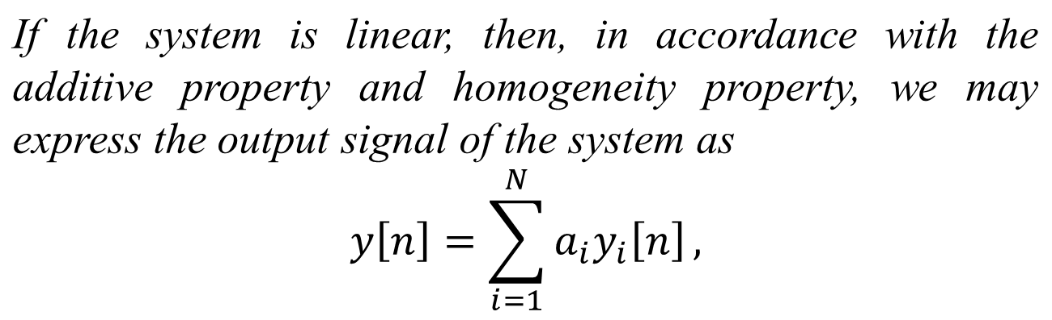
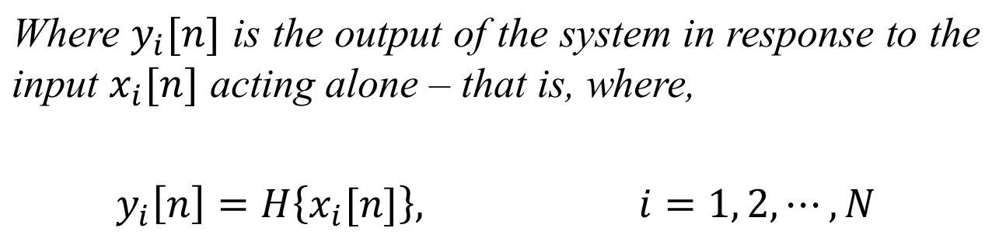
Properties of system
Linearity

Slide 49
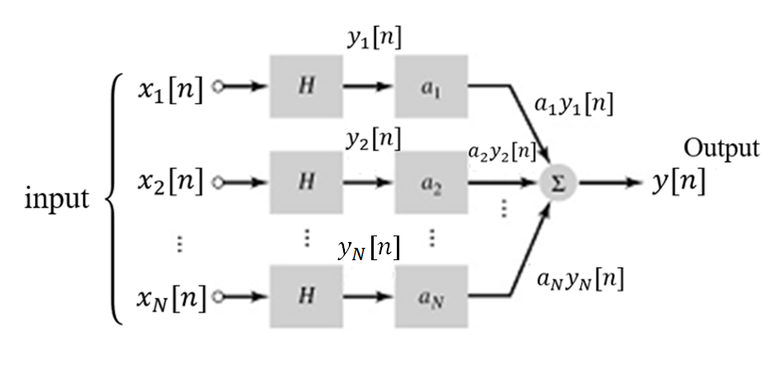
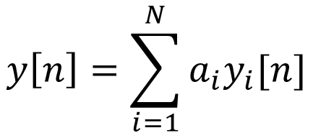
Properties of system
Linearity

Slide 50
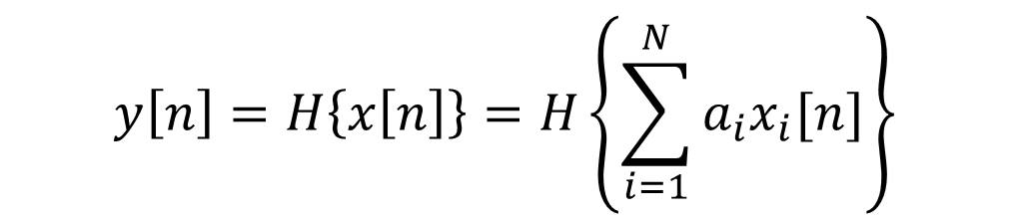
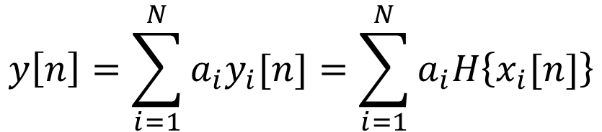
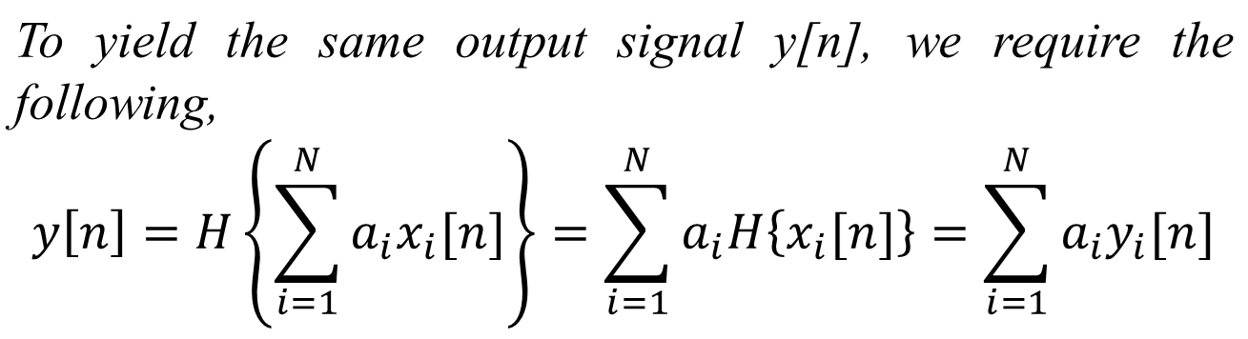
Properties of system
Linearity

Slide 51
Properties of system
Linearity
The linearity property of a system. (a) The combined operation of amplitude scaling and summation precedes the operator H for multiple inputs. (b) The operator H precedes amplitude scaling for each input; the resulting outputs are summed to produce the overall output y[n]. If these two configurations produce the same output y[n], the operator H is linear.
(a)
(b)

Slide 52
Properties of system
Linearity
When a system violates either the additive property or the property of homogeneity, the system is said to be nonlinear.

Slide 53
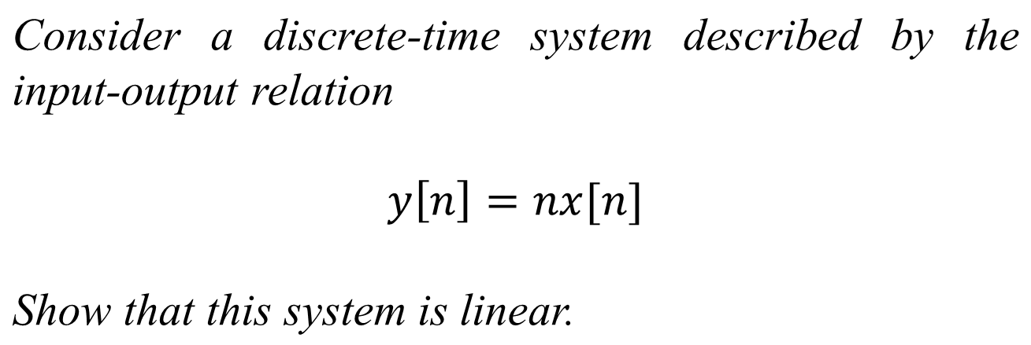
Properties of system
Linearity

Slide 54
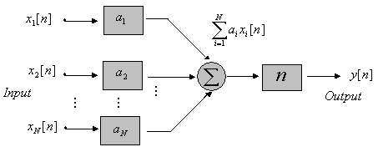
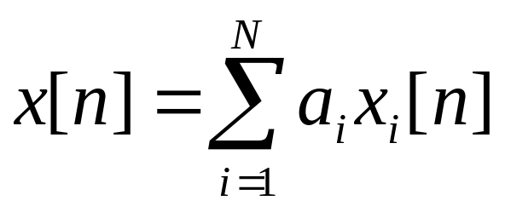
Properties of system
Linearity
Let the input signal x[n] be expressed as the weighted sum.

Slide 55
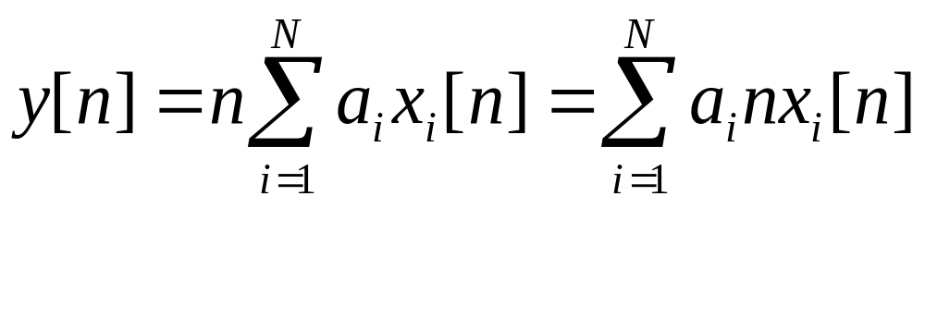
Properties of system
Linearity
The resulting output signal of the system is,

Slide 56
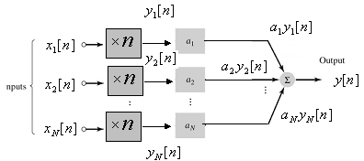

Properties of system
Linearity
Since the two configurations produce the same output y(t), the operator H is linear.

Slide 57

Properties of system
Linearity
Consider a discrete-time system described by the input-output relation
Check the system for linearity.

Slide 58

Properties of system
Linearity

Slide 59


Properties of system
Linearity

Slide 60

Properties of system
Linearity

Slide 61

Properties of system
Linearity

Slide 62

Properties of system
Linearity

Slide 63


Properties of system
Linearity
This is known as “zero-in/zero-out” property.

Slide 64
Properties of system
Linearity
Consider a discrete-time system described by y[n]=2x[n]+3.
Here it can be seen that y[n]=3 if x[n]=0, so the system violates the zero-in/zero-out property of linear systems. Hence the system is not linear.

Slide 65

Properties of system
Linearity
Show that the moving average system described by
is linear.

Slide 66

Properties of system
Linearity

Slide 67

Properties of system
Linearity

Slide 68





Properties of system
Linearity (Exercise): Determine whether the systems are linear or not.

Slide 69
End

